Slide 1

RUNGTA COLLEGE OF DENTAL SCIENCES & RESEARCH
TITLE OF THE TOPIC
Apexogenesis & Apexification
DEPARTMENT OF CONSERVATIVE DENTISTRY AND ENDODONTICS

Slide 2
Specific learning Objectives
At the end of this presentation the learner is expected to know
Core areas* H | Domain ** | Category #
Defination indications and contraincations medicaments used | Cognitive | Must know
Diagnosis,types | Psychomotor | Nice to know
One visit apexification | Affective | Desire to know
*Subtopic of importance
** Cognitive, Psychomotor or Affective
# Must know , Nice to know & Desire to know

Slide 3
CONTENTS
INTRODUCTION
DEFINITION- OPEN APEX
CAUSES OF OPEN APEX
TYPES OF OPEN APEX
STAGES OF ROOT DEVELOPMENT
PROBLEMS ASSOCIATED WITH IMMATURE APEX
DIAGNOSIS AND TREATMENT ASSESSMENT
APEXOGENESIS: INDICATION, CONTRAINDICATION
GOALS OF APEXOGENESIS
PROCEDURE
FOLLOW UP
APEXIFICATION: INDICATIONS, CONTRAINDICATIONS, OBJECTIVES
VARIOUS APPROACHES
ONE VISIT APEXIFICATION
RESULTS OF APEXIFICATION BY FRANK
MEDICAMENTS USED: CALCIUM HYDROXIDE, MTA, BIODENTINE
CONCLUSION
REFERNCES

Slide 4
INTRODUCTION
Treatment of pulpal injury in young permanent teeth posses a special challenge to the dentist .
Depending on the vitality of the affected pulp, two approaches are possible:
1, Apexogenesis/maturogenesis- A vital pulp therapy procedure performed to encourage continued physiological development and formation of root end.
2, Apexification- It’s a method to induce a calcified barrier in root with an open apex or the continued apical development of an incomplete root in teeth with necrotic pulp.

Slide 5
Definition – open apex
Due to trauma or carious exposure, the pulp undergoes necrosis, dentin formation ceases and root growth is arrested. The resultant immature root will have an apical opening that is very large. This is called an open apex, also referred to previously as a blunderbuss canal.
(Thomas R.Pittford,1989)

Slide 6
Causes of open apices
Caries with pulp involvement,
Extensive resorption of the mature apex as a result of orthodontic treatment
Periapical pathosis,
Trauma causing necrosis
This open apex causes two major problems.
The normal crown /root ratio is compromised and may cause mobility.
It becomes difficult to achieve an apical seal with conventional root canal filling.

Slide 7
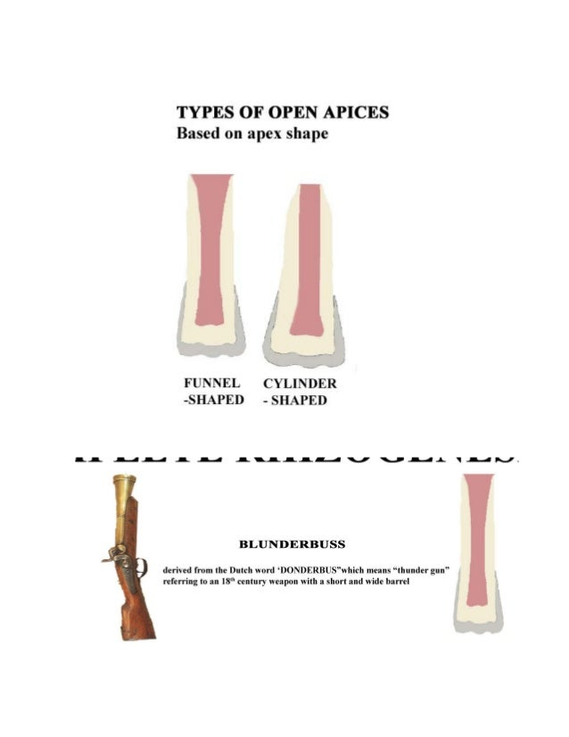
Types of open apices
These can be of two configurations:
1- non-blunderbuss
2- blunderbuss
Non –blunderbuss:
The apex -
Broad (cylinder shaped)
Tapered (convergent)
2. Blunderbuss:
Divergent and flaring root canal wall in which apex is funnel shaped and typically wider than coronal aspect of canal

Slide 8
Pulp injury in teeth with developing roots
Hertwig epithelial sheath help in the development of root length for a favourable crown root ratio.
Hertwig Sensitive to trauma – increase vascularity and cellularity
Important role of Hertwig’s epithelial root sheath in continued root development after pulpal injury, every effort should be made to Maintain its viability.
Unfortunately traumatic injuries to young permanent teeth are not uncommon and are said to affect 30% of children.
The majority of these incidents occur before root formation is complete and may result in pulpal inflammation or necrosis.

Slide 9
Complete destruction of Hertwig’s epithelial root sheath results in
cessation of normal root development
Hard tissue can be formed by :
Cementoblasts - apical region
Fibroblasts of the dental follicle
Periodontal ligament that undergo differentiation after the injury to become hard tissue producing cells

Slide 10
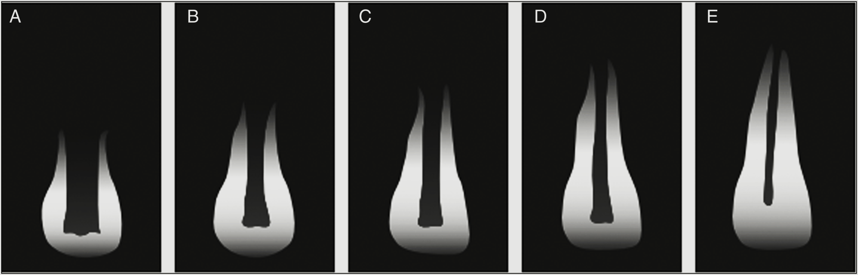
Stages of root development
Cvek 1972

Slide 11
Problems associated with immature apex
Large open apices
Thin dentinal walls
Frequent periapical lesions
Short roots
Fracture of crown
Discoloration on long standing

Slide 12
Diagnosis and case assessment
Clinical assessment of pulp status, clinical & radiographic examination. Subjective symptoms
Pain history – spontaneous, severe, long lasting
Throbbing, tender to touch - pulpal necrosis with apical periodontitis or acute abscess
Swelling /sinus tract - indicates pulpal necrosis and acute or chronic abscess respectively
Tenderness to percussion -inflammation in the periapical tissues.

Slide 13
Treatment
Treatment is based on the vitality of the pulp.
If the immature tooth has vital pulp, exhibiting reversible pulpitis, then physiological root end development or apexogenesis is attempted.
On the other hand if irreversible pulpitis is present or pulp is necrotic, then root end closure or apexification is induced.

Slide 14
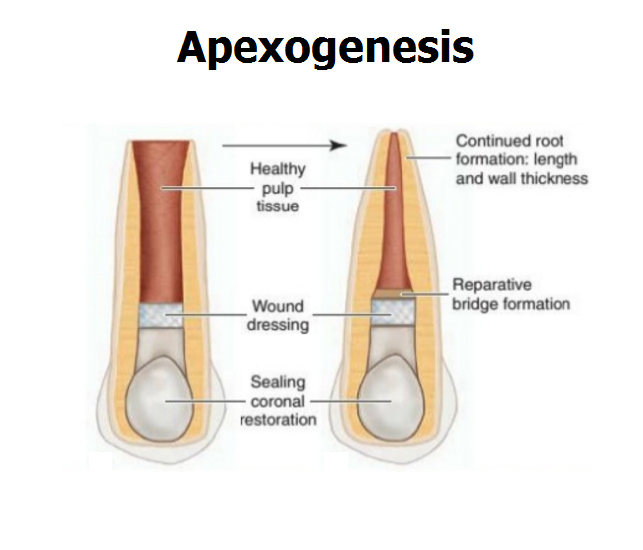
Apexogenesis/ vital pulp therapy
Apexogenesis is defined as treatment of a vital pulp in an immature tooth to permit continued root growth and apical closure. A vital pulp of an immature tooth may have a small exposure after trauma.” - Ingle

Slide 15
INDICATIONS
Immature tooth with incomplete root formation and damage to the coronal pulp but with a presumed healthy radicular pulp.
Lack of abscess formation, excessive haemorrhage, no foul odour
Normal radiographic appearance
Absence of sensitivity to percussion
No abnormal responses to thermal stimuli

Slide 16
CONTRAINDICATIONS
Avulsed and replanted or severely luxated tooth
Severe crown root fracture that requires intraradicular retention for restoration
Tooth with an unfavorable horizontal root fracture (i.e. close to the gingival margin)
Carious tooth that is unrestorable

Slide 17
Goals of Apexogenesis : (Weber 1984)
Sustaining a viable Hertwigs Sheath, thus allowing continued development of root length for a more favorable crown to root ratio.
Maintaining pulpal vitality, thus allowing the remaining odontoblasts to lay down dentin, producing a thicker root and decreasing the chance of root fracture.
Promoting root end closure, thus allowing a natural apical constriction for root canal filling. Generating a dentinal bridge at the site of pulpotomy

Slide 18
PROCEDURE
Anesthetize and isolate.
After local anesthesia, rubber dam isolation,
a conventional access cavity was made with a
high-speed bur using copious water spray.
Strands of pulp and debris were removed coronal to the amputation site.
Amputation of the coronal pulp at the cervical level was
performed with a sharp spoon excavator or a large sterile round bur.

Slide 19
Bleeding of the pulp stump was controlled with saline on a cotton pellet
applied with gentle pressure.
[Ca(OH)2]: Calcium hydroxide powder was mixed with saline to a thick
consistency. The paste was carefully placed on the pulp stump surface 1 to 2 mm thick.
Removal of coronal pulp
Haemostasis

Slide 20
Calcium hydroxide placement

Slide 21
Follow-up
Time required
1 and 2 years depending on the degree of tooth development at the time of the procedure.
Recalled every 3 months

Slide 22
Clinically, the treatment was considered successful if there were no signs or symptoms of pulp or periapical disease (no history of pain and no clinical evidence of swelling or sinus tract).
Radiographically, the treatment was considered successful if there was continued growth of the root and canal narrowing, and no widened periodontal ligament, no periapical radiolucency and no internal or external root resorption.

Slide 23
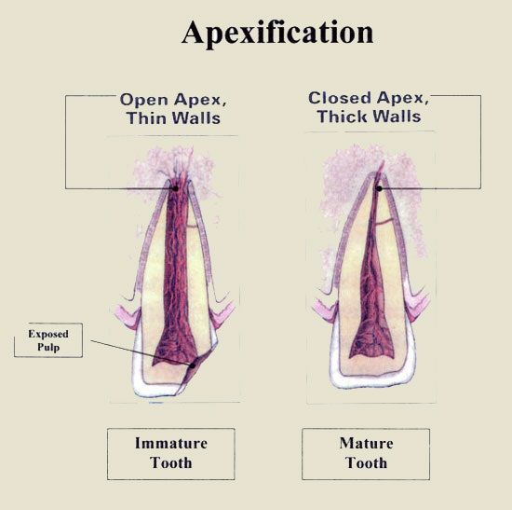
Apexification
Defined as the method of inducing apical closure by the formation of osteo cementum or a similar hard tissue or the continued apical development of the root of an incompletely formed tooth in which the pulp is no longer vital.
– American Association of Endodontics

Slide 24
‘Root-End Closure’, introduced by Torabinejad in 2002.
Indication – restorable immature tooth with pulp necrosis.
Contraindications
All vertical and unfavorable horizontal root fractures.
Very short roots
Periodontal breakdown

Slide 25
Objectives
Induce root end closure
No evidence of post treatment signs and symptoms
No evidence of calcification
No internal or external resorption
No breakdown of periradicular supporting tissues

Slide 26
According to Morse et al., (1983) various approaches :
Blunt end or rolled cone (customized cone)
Short fill technique
Periapical surgery (with /without retrograde seal)
Apexification (apical closure induction)

Slide 27
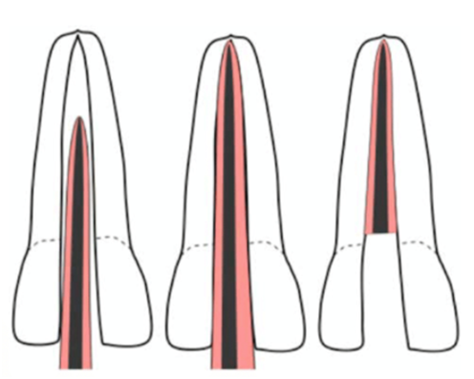
Blunt end or rolled cone (customized cone)
Filling the root canal with the large end of gutta percha cone is customized cone is not advisable because the apical foramen isgenerally wider than the root canal orifice.
This would prevent proper condensation of the gutta percha and proper preparation of the canal would weaken the tooth considerably
It would also be difficult to assess the point of root development radiographically because root formation in the buccolingual plane is less advanced than
it is in the mesiodistal plane.

Slide 28
Short fill
Moodnick proposed removal of the bulk of the necrotic tissue & filling the root canal short of the apex with gutta Percha
He advocated use of Diaket ( premier dental products).
It is a compound of beta ketones & zinc oxide in place of gutta percha to enhance healing.
However with an incomplete obturation, microbes can be left remaining within the apical part of the root canal system & healing may not take place or periapical breakdown may occur later.

Slide 29
Periapical surgery
The gutta percha/ sealer surgical approach has many drawbacks. Many clinicians do not advocate this method of treatment for one or more of the following reasons:
Relative to the already shortened roots, further reduction could result in an inadequate crown to root ratio.
Surgery could be both physically & psychologically traumatic to the young patient.
The young patient is non cooperative
Surgery would remove the root sheath & prevent the possibility of further root development

Slide 30
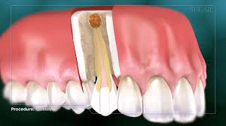
The apical walls are thin & could shatter when touched by a rotating bur
The periapical tissue may not adapt to the wide & irregular surface of the amalgam
The thin walls would make condensation of a retrograde material difficult.
This can result in an inadequate seal.

Slide 31
Apical closure induction
Most widely used approach but exact mechanism unknown.
It has been considered that treatment of teeth with necrotic pulp the basic aim should be stimulation & preservation of the formative activity of the granulation tissue cells in apical part of the root canal.
This should enhance the formation of a calcified callus in the wide apical opening.

Slide 32
Take home message
The practitioner should strive to achieve root development through apexogenesis wherever possible.
If this treatment fails or pulp is necrotic, apexification should be initiated. However, the most important factors are debridement of the canal and closure of this space with a suitable material.
These aspects allow the body to reorganize and repair the periapical tissues.

Slide 33
QUESTION & ANSWERS
WRITE A NOTE ON APEXIFICATION?
WRITE A NOTE ON APEXOGENESIS

Slide 34
REFERENCES
ORBAN’S HISTOLOGY AND EMBRYOLOGY 12TH EDITIONANTONIO NANCI- TEN CATE’S ORAL HISTOLOGY- DEVELOPMENT STRUCTURE AND FUNCTION- 6TH EDITION
Endodontic practices - Grossman
Pathways of pulp – Cohen
Textbook of Endodontics – Nisha Garg
Endodontics - Ingle

Slide 35
Suggested reading
Endodontic practices - Grossman
Pathways of pulp – Cohen
Textbook of Endodontics – Nisha Garg
Endodontics - Ingle

Slide 36
THANK YOU!

